Slide 1

Netflix Data Analysis
Pranav Shankarrao Narwade
APPLY_175572280268a634328d64d

Slide 2

PROBLEM STATEMENT
This project analyses the Netflix dataset (7,789 titles) to uncover content trends. The aim is to understand how Netflix's content distribution (Movies vs. TV Shows, genres, and country contributions) has evolved, providing strategic insights for global content expansion.

Slide 3
Project Description
Netflix is one of the world's most prominent global streaming platforms. As competition grows, it is crucial for Netflix to make data-driven decisions. This project will analyse the Netflix dataset (7,789 records) to uncover trends in its content catalog that can inform strategic recommendations.

Slide 4

WHO ARE THE END USERS?
Netflix Executives
Content Strategy & Acquisition Teams
Market Analysts
Business Intelligence Teams

Slide 5

Technology Used
Python
Pandas (for data cleaning and analysis)
Matplotlib & Seaborn (for data visualization)
Google Colab (as the notebook environment)

Slide 6
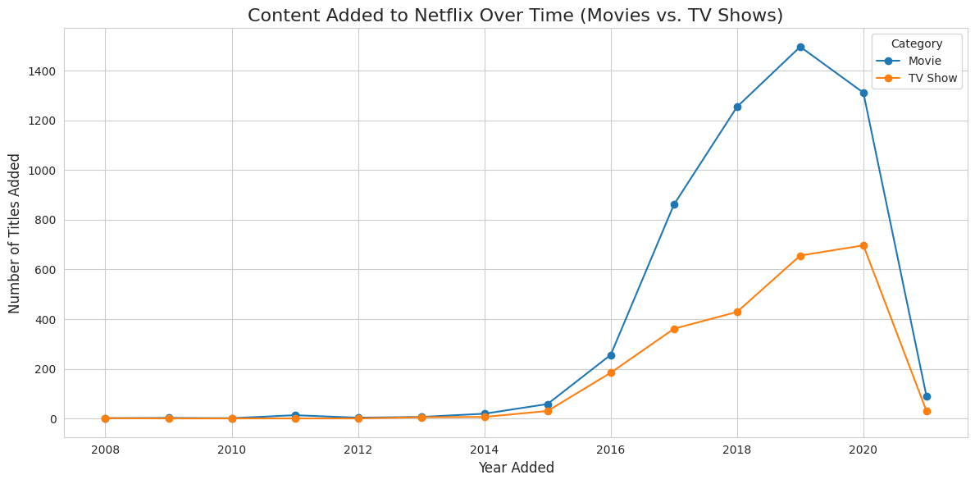
RESULTS1
Growth of Movies vs. TV Shows
Insight: Netflix's content library spiked after 2015. TV Show production has grown faster than movie production, showing a strategic shift to original series.

Slide 7
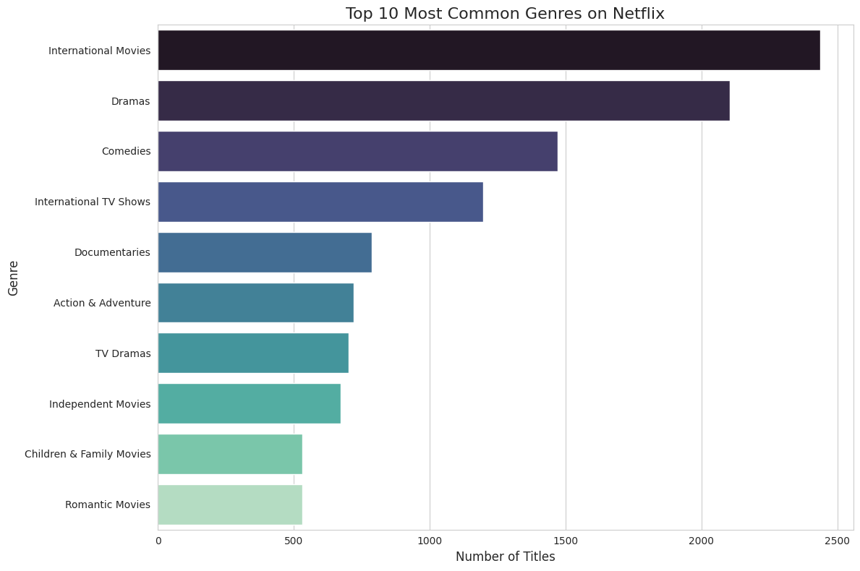
RESULTS2(1)
Top 10 Common Genres
Insight: "International Movies" and "Dramas" are the top categories. The focus on international content proves Netflix's global expansion strategy.

Slide 8
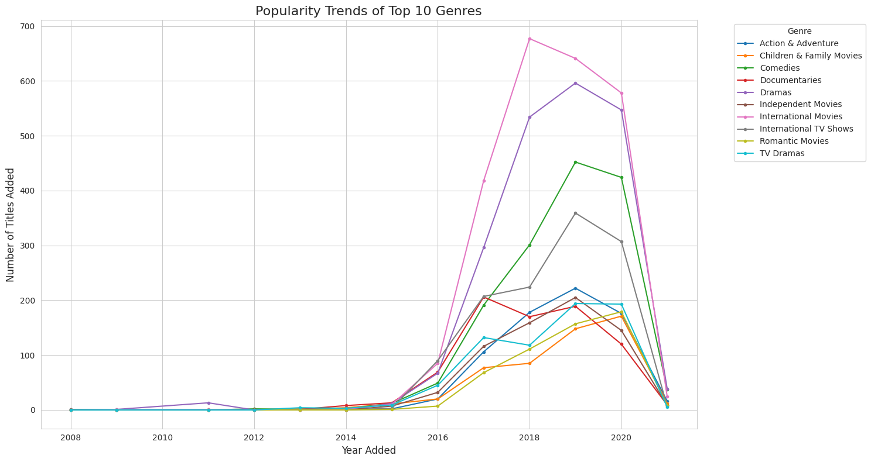
RESULTS2(2)
Popularity Trends of Top Genres
Insight: "International Movies" and "Dramas" are the top categories. The focus on international content proves Netflix's global expansion strategy.

Slide 9
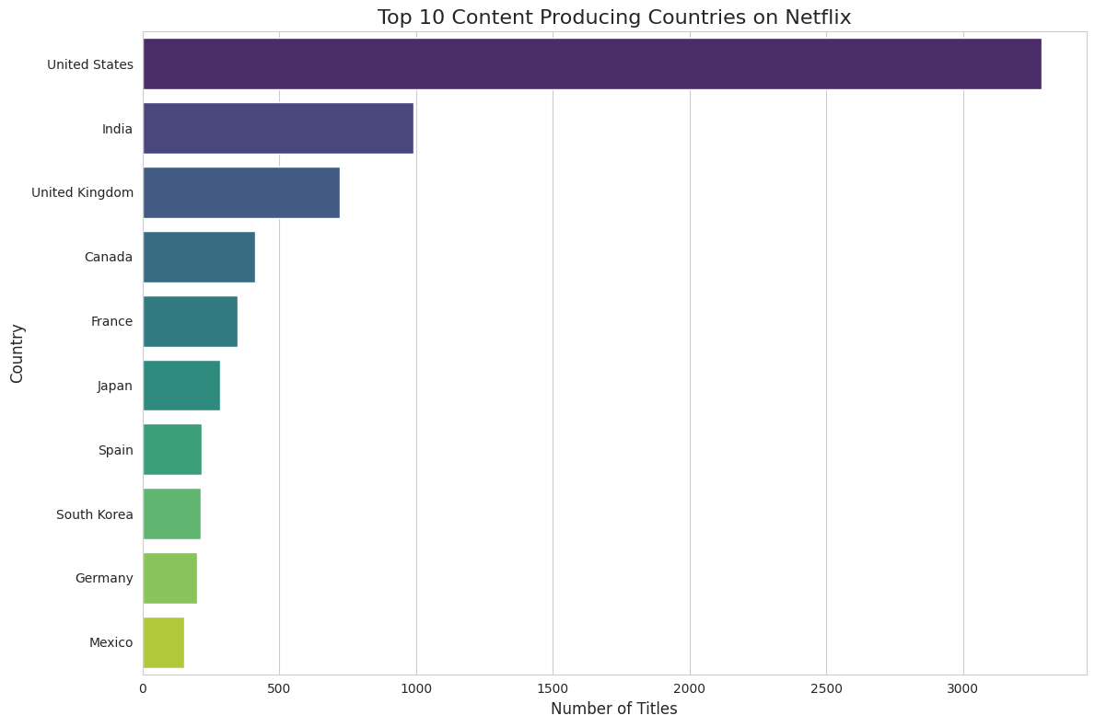
RESULTS3
Top Content Countries
Insight: The US is the #1 producer, but India and the United Kingdom are #2 and #3, showing a clear strategy of investing in key international markets.

Slide 10
GitHub repository
https://github.com/PranaVNarwade04/VOIS_AICTE_Oct2025_MajorProject_PranavShankarraoNarwade

Slide 11
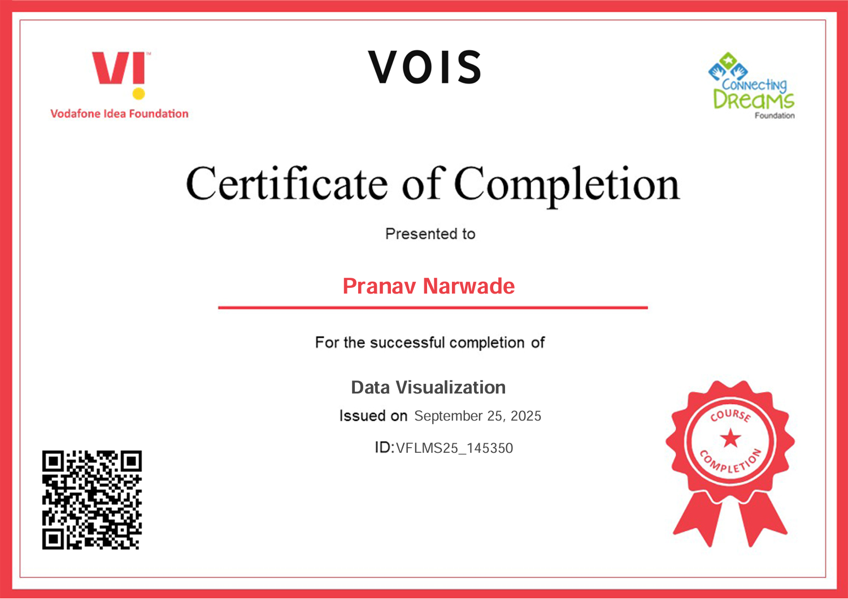
Getting started with Basics of Python Certificate

Slide 12

Data Visualization Certificate

Slide 13
Thank you
.
.

